Slide 2








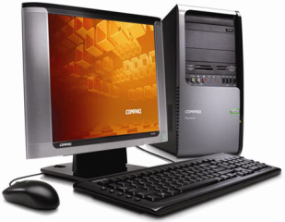
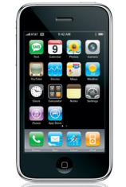

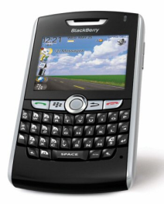
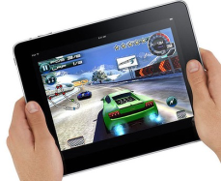

Chrome
Windows
Mosaic
Flash
FireFox
Android
WWW
WAP
IE
Silverlight
1980
1990
2000
2010
Desktop
iPhone
Laptop
BlackBerry
iPad
Netbook

Slide 3
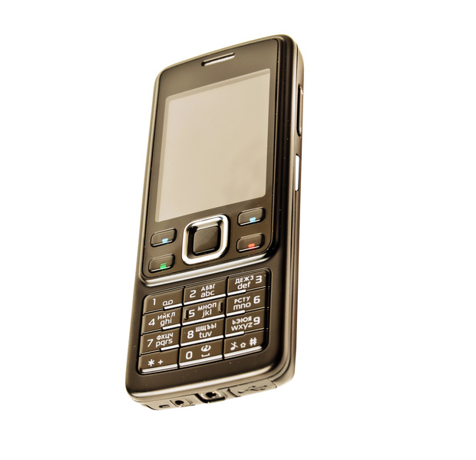



Slide 4


Web Team
Mobile Team
Coordinator
Desktop Team

Slide 5
Unified
Application Team

Slide 6
Styling
Transformations
Templating
WPF
WinForms
interop
Databinding
Animation
3D
XAML

Slide 7
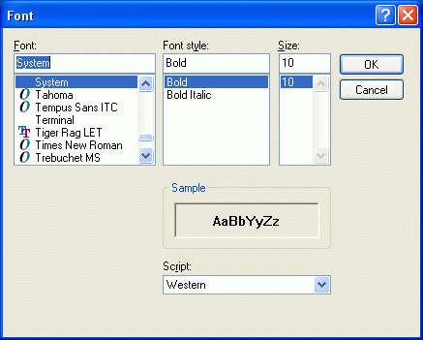
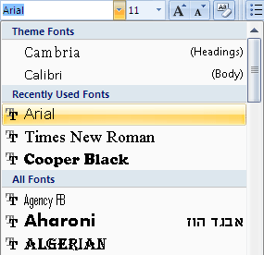
Word 2002
Word 2007

Slide 8
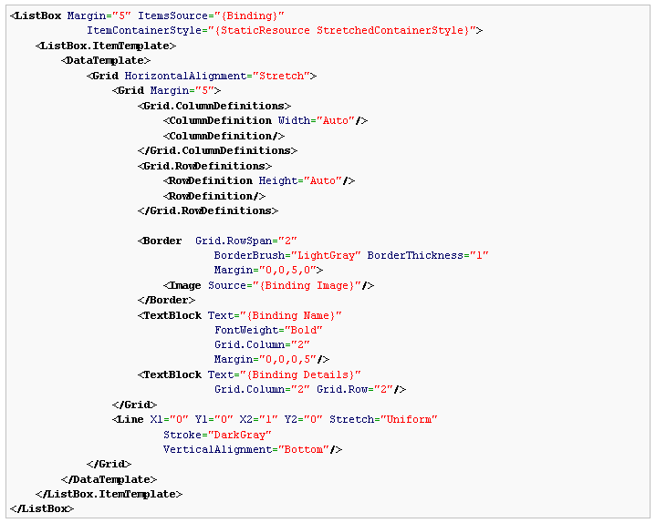
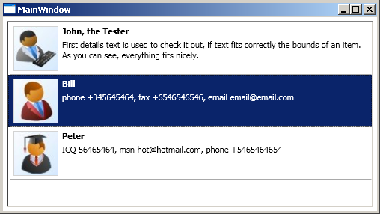

Slide 9
Styling
Transformations
Templating
Silverlight
WinForms
interop
Databinding
Animation
3D
XAML

Slide 11
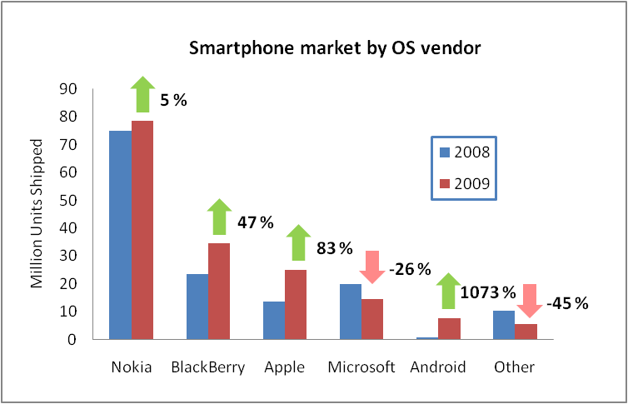

Slide 12
Styling
Transformations
Templating
Silverlight
For WP7
WinForms
interop
Databinding
Animation
3D
XAML

Slide 13
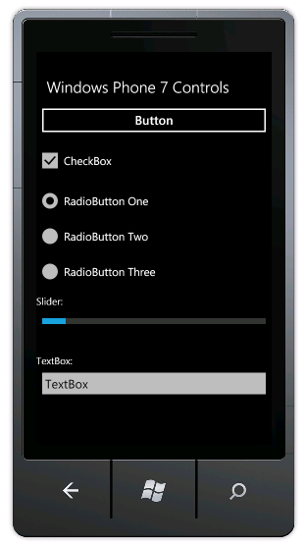
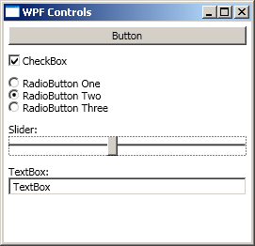
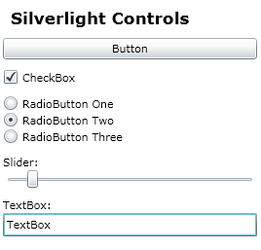

Slide 14
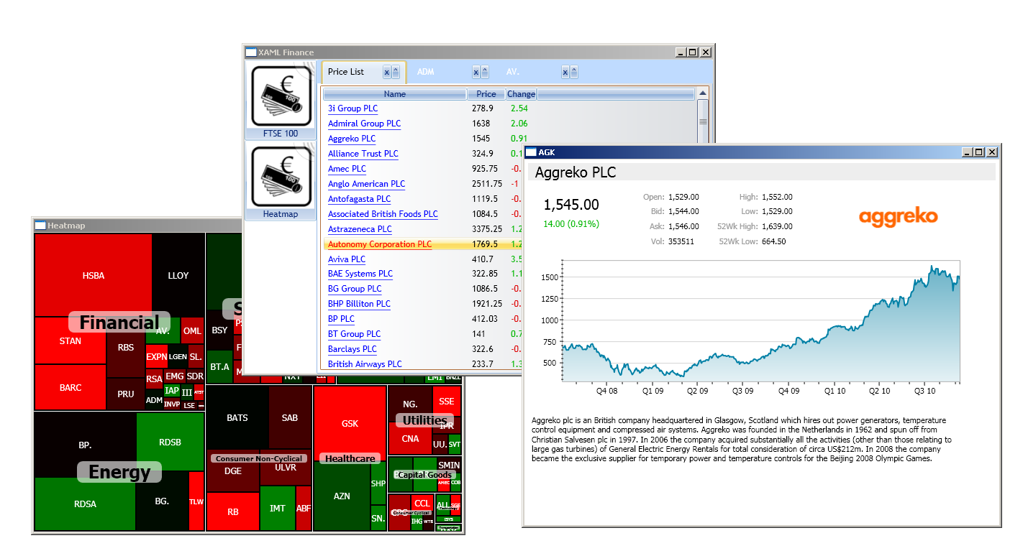

Slide 15
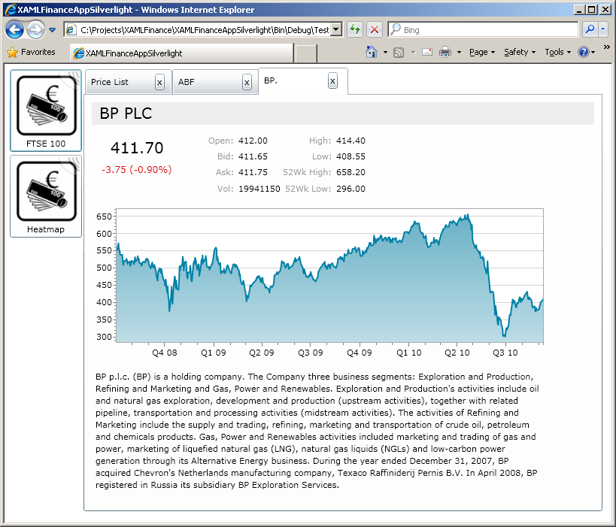
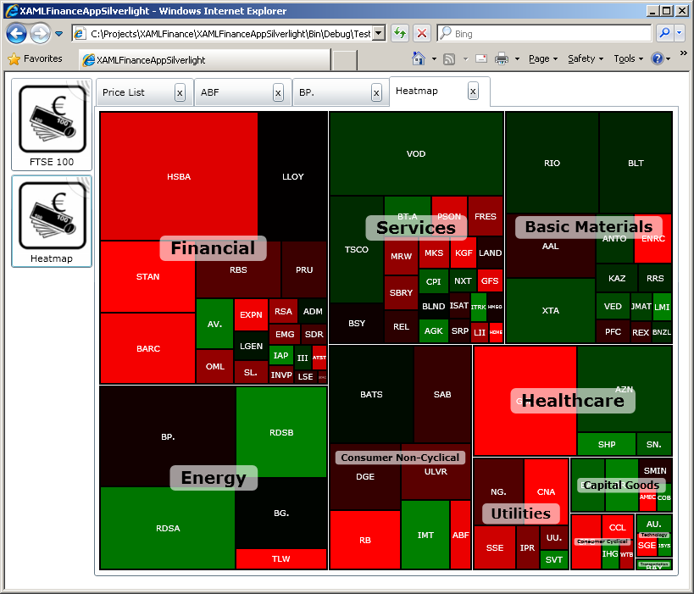
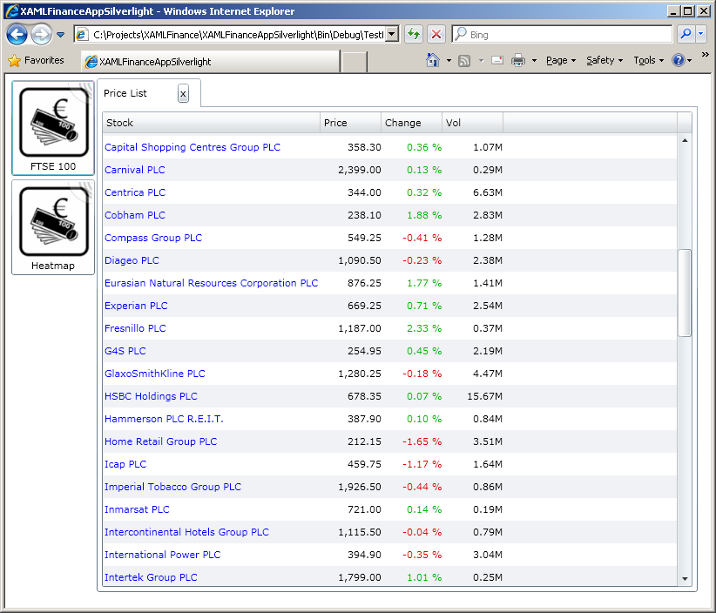

Slide 16
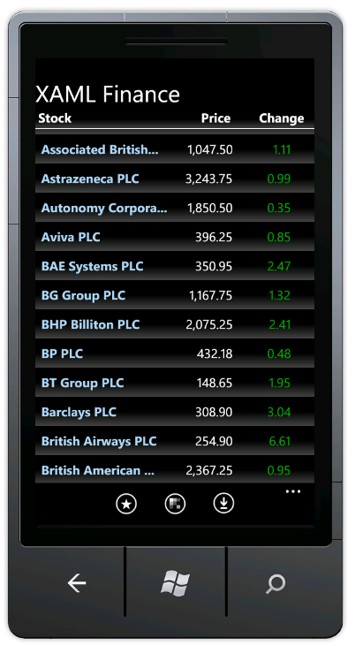
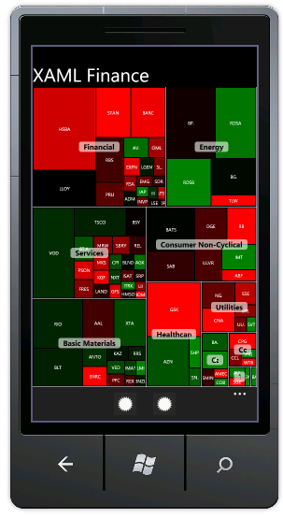
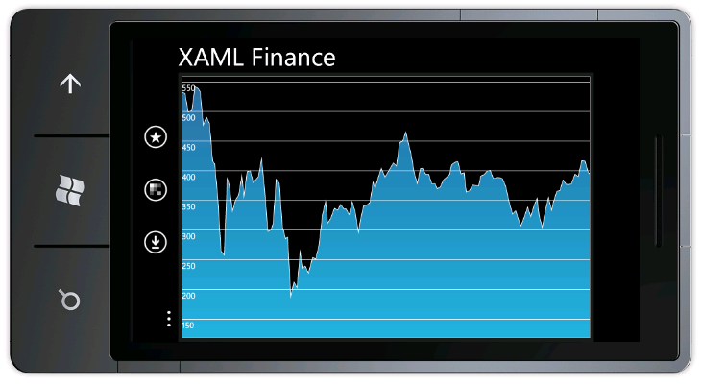

Slide 18
The “good” bits
WPF
Silverlight
WP7

Slide 19
